Slide 1
School Logo
Password
SSN
Login

Slide 2












Report
Students
Teachers
schedule
Levels
Exams
Attendance
Activities
Exams Table
Logout

Slide 3

Home
Report
Report Type
Number Of Student | 150
Number Of Teachers | 25
Success Rate | 80%
Failure Rate | 20%
Generate
Clear

Slide 4


Home
Students
National ID
Student Name
Numbers | National ID | Student Name | Gender | Birth Date | City | Mobile | Level | religion | Password | Parent Password
1 | 01234567890123 | Ahmed Abdelmoneim Mohamed Ahmed | m | 2004/10/10 | Benisuef | 01207179348 | First | Muslim | 12345 | 03375
Gender
Birth Date
City
Mobile
Level
Religion
Password
+ Add

Slide 5

Home
Teachers
National ID
Teacher Name
Numbers | National ID | Teacher Name | Role | Birth Date | City | Mobile | Password | Qualification
1 | 01234567890123 | Hossam Mostafa Taha Ahmed | 1 | 2004/10/10 | Benisuef | 01207179348 | 11111 | Social Service
2 | 22344701244775 | Khaled Ahmed Ali Hassan | 2 | 2003/01/30 | Beba | 01501267436 | 22222 | English
Role
Birth Date
City
Mobile
Password
Qualification
+ Add

Slide 6

Home
Levels
First
Second
Third
Numbers | National ID | Student Name | Gender | Birth Date | City | Mobile | Religion | Password
1 | 01234567890123 | Ahmed Abdelmoneim Mohamed Ahmed | m | 2004/10/10 | Benisuef | 01207179348 | Muslim | 12345
2 | 120155451214557 | Belal Mohamed Abass Ahmed | m | 2004/06/04 | Beba | 01102548910 | Muslim | 46328

Slide 7

Home
Exams
First
Second
Third
Numbers | National ID Student Name | Student Name | Midterm 1 | Midterm 2 | Final | Percentage | Get Details
 |  |  | 100 | 19 | 500
1 | 120155451214557 | Belal Mohamed Abass Ahmed | 85 | 90 | 410 | 83.3%
2 | 01234567890123 | Ahmed Abdelmoneim Mohamed Ahmed | 90 | 83 | 435 | 87.5%
details
details

Slide 8

Home
Attendance
Choose Level
Numbers | National ID | Student Name | Total Absences | Notice | Geف Details
1 | 01234567890123 | Ahmed Abdelmoneim Mohamed Ahmed | 15 | Yes
2 | 11447702214711 | Mohamed Samir Sadeik Solaiman | 7 | -
Choose Class
details
details

Slide 9

Home
Schedule
Day | First | Second | Third | Fourth | Fifth | Sixth | Seventh | Eighth
Sunday | Math |  | Social Studies |  | - | Science |  | -
Monday | Arabic |  |  | Math | - | English |  | Art Education
Tuesday |  |  |  |  | -
Wednesday |  |  |  |  | -
Thursday |  |  |  |  | -
Choose Level
Choose Class
Lesson name
Lesson day
Lesson number
+ Add

Slide 10
Home
Activities
Choose activity
Numbers | National ID | Student Name | level | class
1 | 01234567890123 | Ahmed Abdelmoneim Mohamed Ahmed | 1 | 1/5
2 | 120155451214557 | Belal Mohamed Abass Ahmed | 1 | 1/4

Slide 11

Home
Exams Table
Choose Level
Day & Date | Subject | Answer Time |  | Time
 |  | From | To
Sunday 2023/12/30 | Math | 90:00 | 11:00 | 2 hours
Monday 2024/1/1 | English | 12:00 | 20:00 | 2 hours
Tuesday 2024/1/2
Wednesday 2024/1/3
Thursday 2024/1/4
Day & Date
Subject
Answer Time From
Answer Time To
Time
+ Add

Slide 12
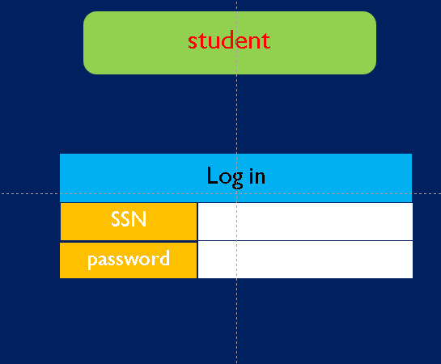


Slide 13
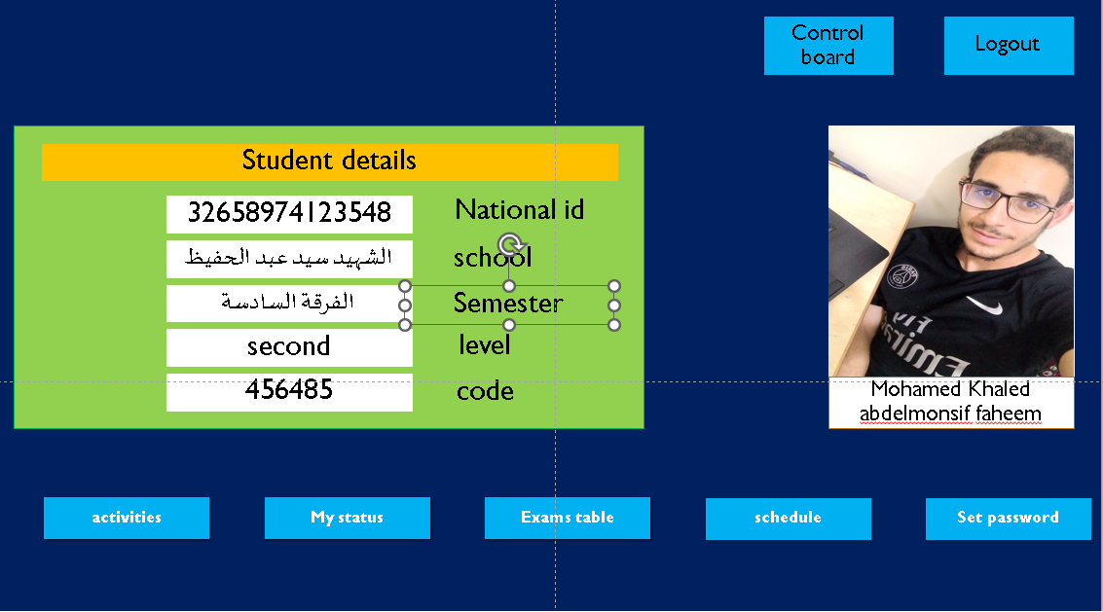
first

